Slide 1
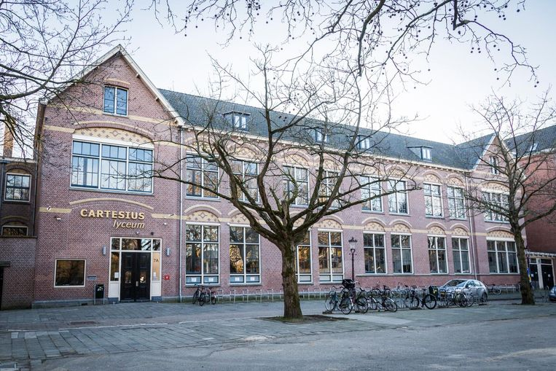
Our school
and sustainable tourism in Amsterdam

Slide 2
Cartesius Lyceum Amsterdam
Location and accessibility
Building
Courses and classes
After school activities
Notes:
Location and accessibility- Our school is located in the old west part of Amsterdam. It is a 15 minute bus ride away from central station, 10 minutes on bike or 30 minutes of walking. There is a bus stop less than 2 minutes away, and there is plenty of space to park bikes.
Building- Our building used to be a different smaller school, and after our school first took over, there were a lot of renovations done. Where there once was a courtyard, we now have our cafeteria, and right above it is our floating gymnasium. We call it that but its actually on poles. The original outside walls are still there, which gives the cafeteria a very unique look.
Courses and classes- Our curriculum takes either 5 or 6 years, depending on which level you do. Aside from level, in your 3rd year you get to choose a course that consists of fewer and more unified classes + a foreign language + one extra class of your choice. The options are Nature and Technique, Nature and Health, Economics and Society, and Culture and Society. I, for example, do Nature and Health, and my classes, aside from Dutch English Math, are Biology, Science, Geography, Economics and German.
After school activities- We have a lot of organizations you can be a part of, such as the GSA, student council, party committee, youth court and more. There are also other activities, such as exchange programs like this, and other trips both within and outside the country.

Slide 3
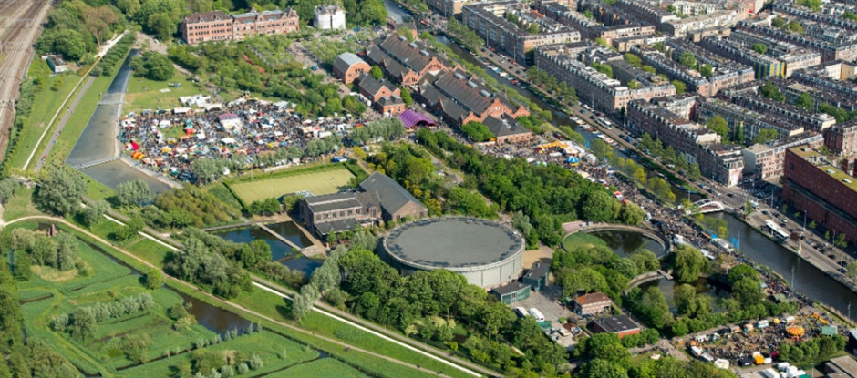
Cartesius lyceum Amsterdam
location and accessibility
Close to the city centre and CS
Westerpark (P.E.)
tram/bus stop
bicycle paths going everywhere
lots of green space around

Slide 4
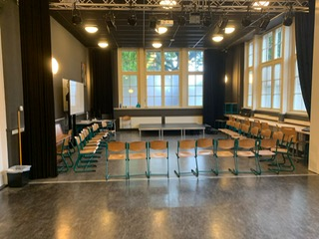
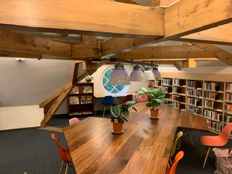
Cartesius Lyceum Amsterdam
Building
first floor
second floor
attic
bicycle parking spaces
small building (circa 700 students)
Notes:
11 classrooms, languages, science, math and biology, music/theatre
13/14 classrooms, languages, physics, geography, history and biology, along with a computer classroom
4 classroom, 2 art classrooms, 2 computer classrooms
Building- Our building used to be a different smaller school, and after our school first took over, there were a lot of renovations done. Where there once was a courtyard, we now have our cafeteria, and right above it is our floating gymnasium. We call it that but its actually on poles. The original outside walls are still there, which gives the cafeteria a very unique look.

Slide 5
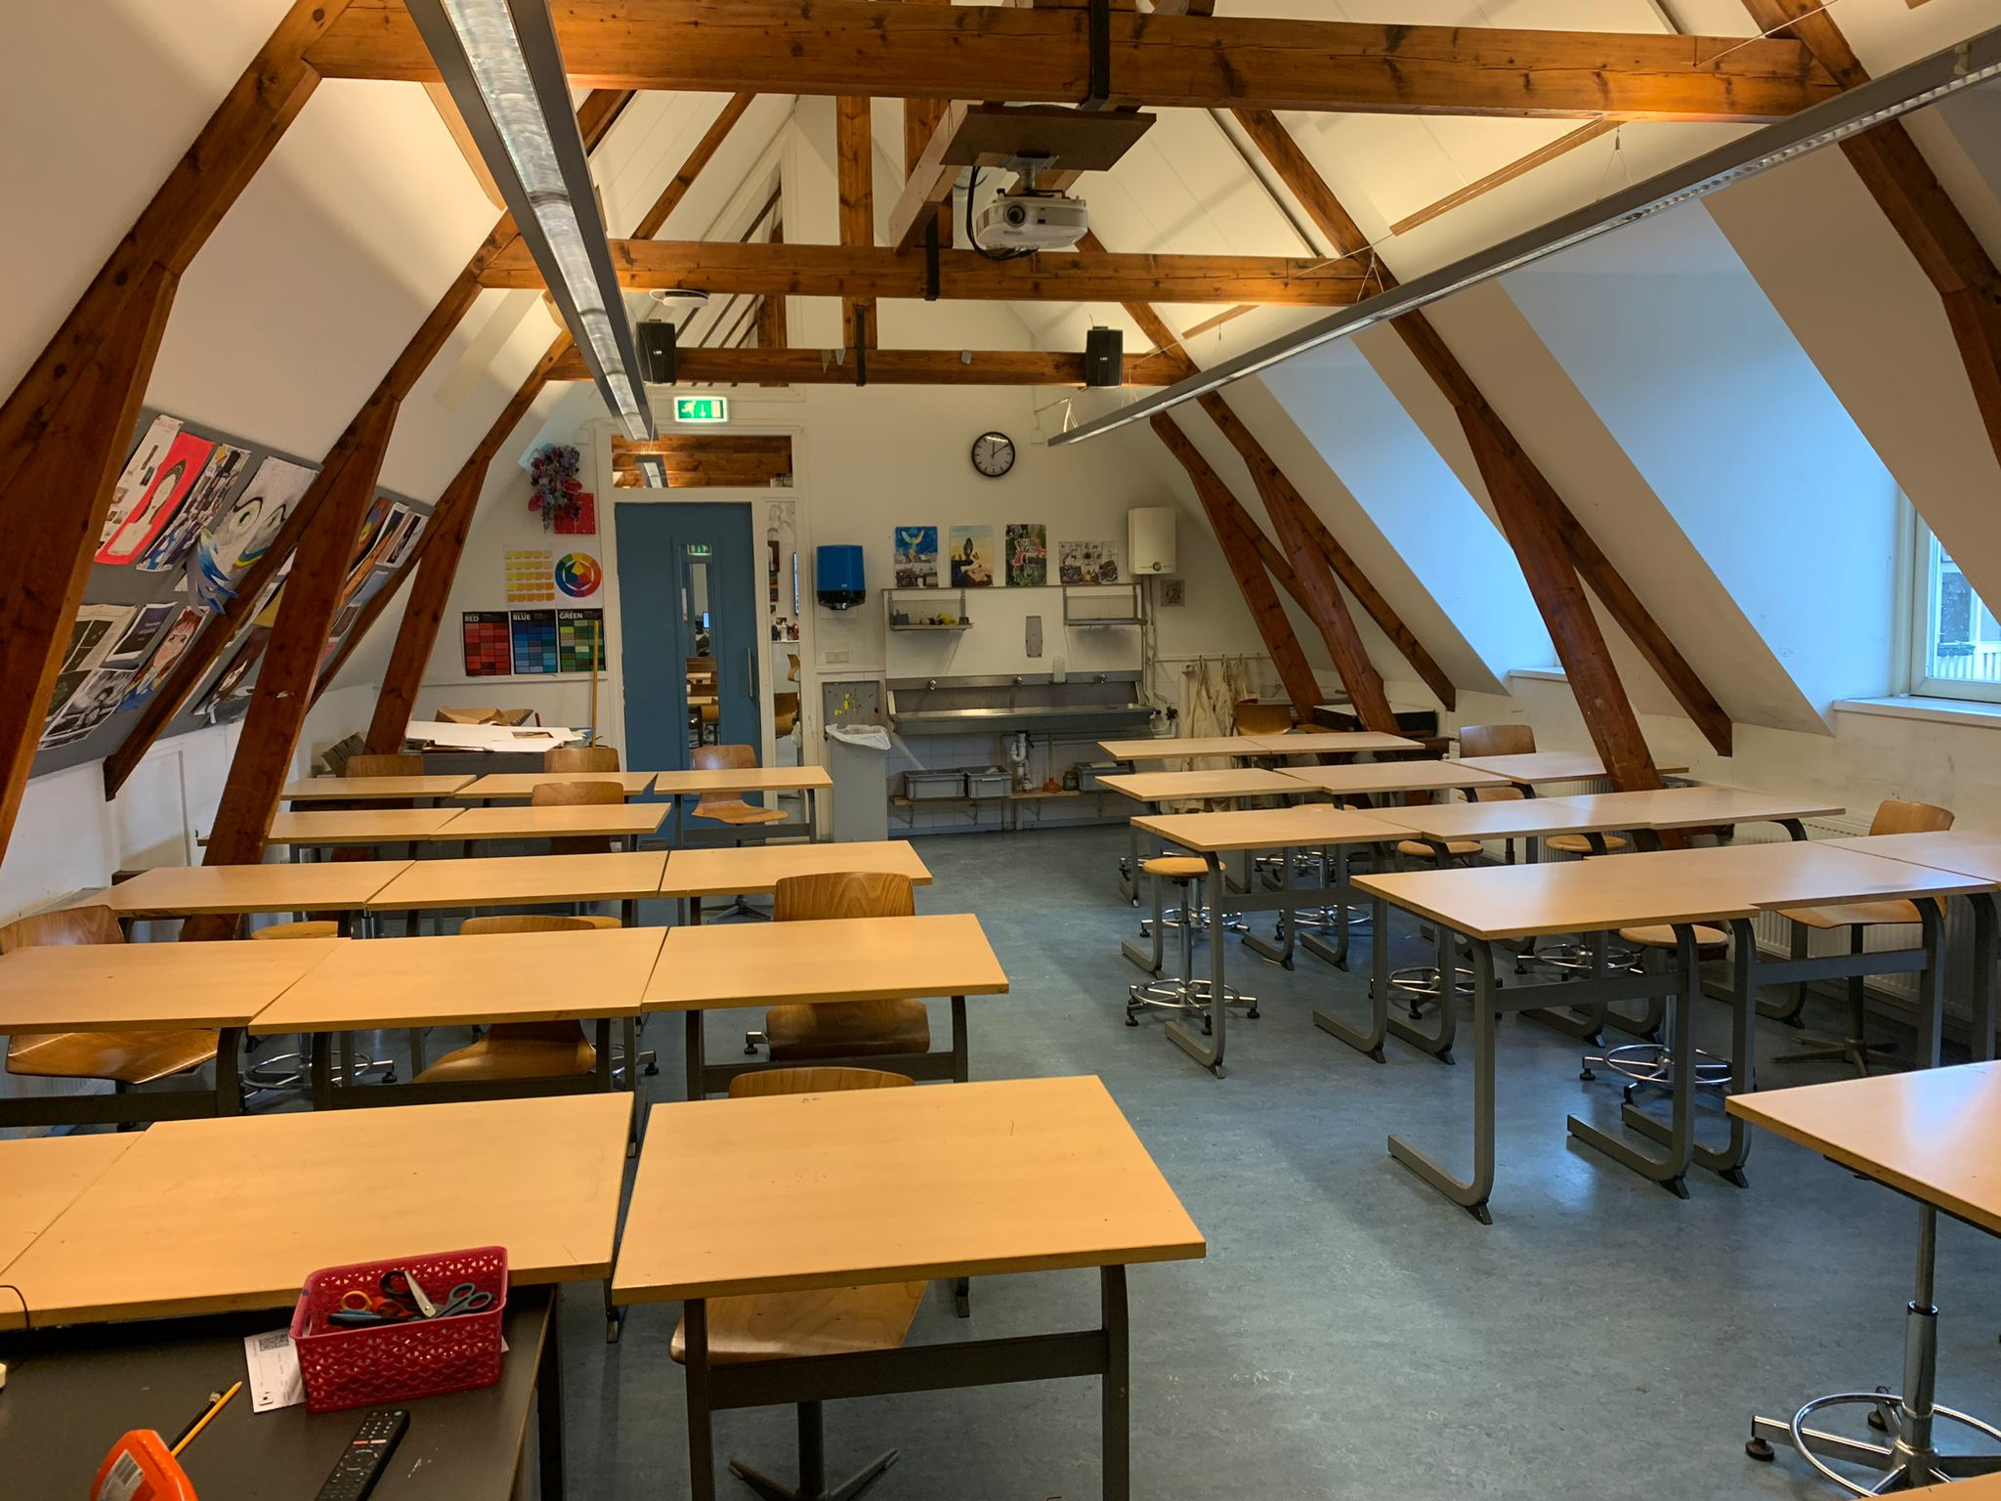
Cartesius lyceum Amsterdam
courses and classes
primary education (8 years)
secondary education (4-6 years)
vmbo/havo/vwo/gymnasium
het cartesius
Courses
languages
P.E., music, theatre and art/culture
after school activities: GSA, debate club, youth court.
Notes:
primary school till 12 years old

Slide 6
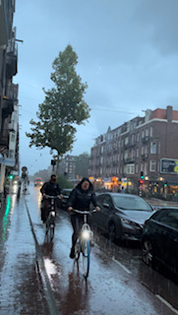
Amsterdam sustainable tourism
Built for bikes
Public Transport
windmills
vegan restaurants
“green” airport
https://youtu.be/YaAwSaMYDyU
Notes:
As you probably know, Amsterdam is built for bikes. There are bike paths everywhere. There are more bikes than people.
On visit in Amsterdam but no bike? No problem. Our public transport system also rents out bikes, for €4.15 per 24 hours. (75.25 Turkish Lira, 31 Danish Crown) They are available all around the city. All you need is a public transport card, which you can get at any station.
We also have trams, metros and trains that partially or fully run green power, and the busses are converting to electric.
Windmills have been used for centuries to move water, grind wheat, and now, generate energy. You are able to visit both the old-school and modern mills in and around Amsterdam.
Amsterdam has plenty of restaurants that serve sustainable, vegan food, such as the Vegan Junk Food Bar.
Since January 2018, our biggest airport, Schiphol, has been running 100% on wind energy generated in the Netherlands.
multiple biological or vegan stores like: marqt, ekoplaza, odin.
But also markets for fresh vegetables and fruit.

