Slide 1

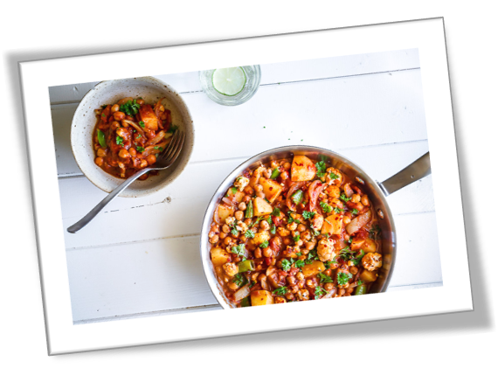
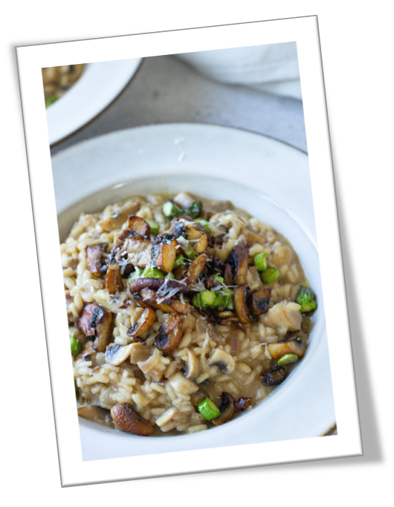

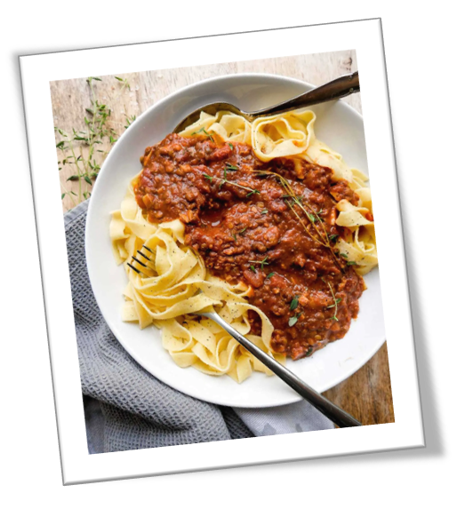
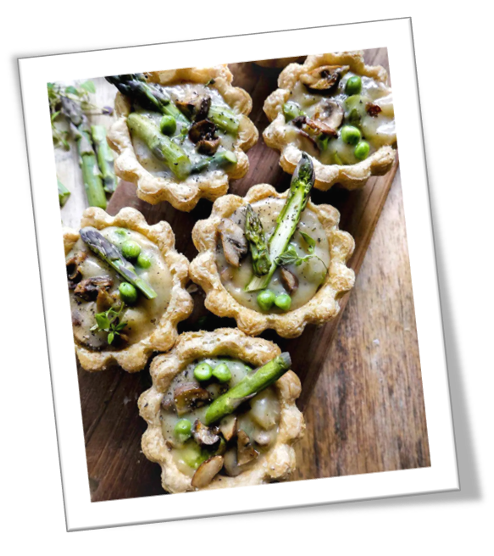
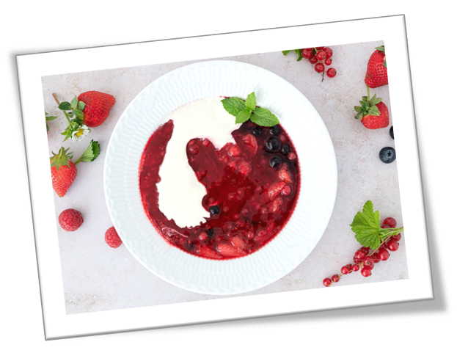

Recipes
Plant Based Food

Slide 2

Hokkaido pumpkin soup
Start by peeling the pumpkins with a good sharp knife
Cut the pumpkins in half or quarters and remove the seeds (just save some of them) and cut into coarse pieces
Peel the onion and garlic and peel the ginger, cut it all into coarse pieces.
Fry onion and garlic blankly along with a little ginger over medium-high heat
Add the pumpkin pieces and a little chili and let it fry in for about 5 minutes
Add the chicken broth until it covers and let the soup cook at medium low flame until the pumpkin pieces are completely tender.
Blend with an immersion blender - from here you can either filter the soup through a strainer for a silky smooth consistency.
Add cream and stir
Season with salt, pepper, chili and possibly a little lemon juice
Approx. 2kg hokkaido pumpkin
2 large onions
2-3 cloves of garlic
50-75 g ginger
Chili to taste
1-1.5 liters of chicken broth
500ml. Cremefin
Olive oil
Salt/pepper

Slide 3
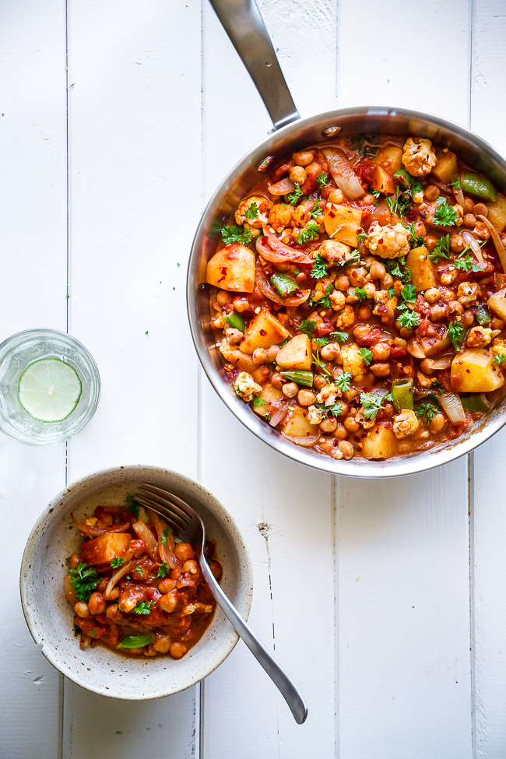
VEGETARIAN CURRY WITH CAULIFLOWER,
POTATOES AND CHICKPEAS
1/2 cauliflower, divided into bouquets
4 medium potatoes
2 onions, in boats
2 cloves garlic, finely chopped
2 tablespoons of oil
2 tsp ground coriander
2 tsp ground cumin
2-3 tsp garam masala
1 pinch of cayenne pepper
1 teaspoon chili flakes
Salt/pepper
1 can of chopped tomatoes
1 pinch of sugar
1 can of chickpeas, drained and rinsed
1 dl coconut milk
10-12 peas. halved
Fresh parsley
Put potatoes and cauliflower in a saucepan with salted water. Bring it to a boil and let them boil 3 minutes. Drain the potatoes and cauliflower in a sieve.
Put oil in a hot pan. Put garlic and onion on the pan and sauté it for a few minutes - without them taking color.
Put cumin, coriander, garam masala and cayenne pepper on the pan and sauté it by 1 minute.
Add chopped tomatoes, chili flakes, sugar, salt and pepper, as well as the boiled potatoes, chickpeas and cauliflower. Turn it all well together on the pan and simmer for 10 minutes.
Pour in coconut milk and cook it all for a few minutes.
Add sugar schnapps and parsley just before serving - season with salt, pepper and chili flakes

Slide 4
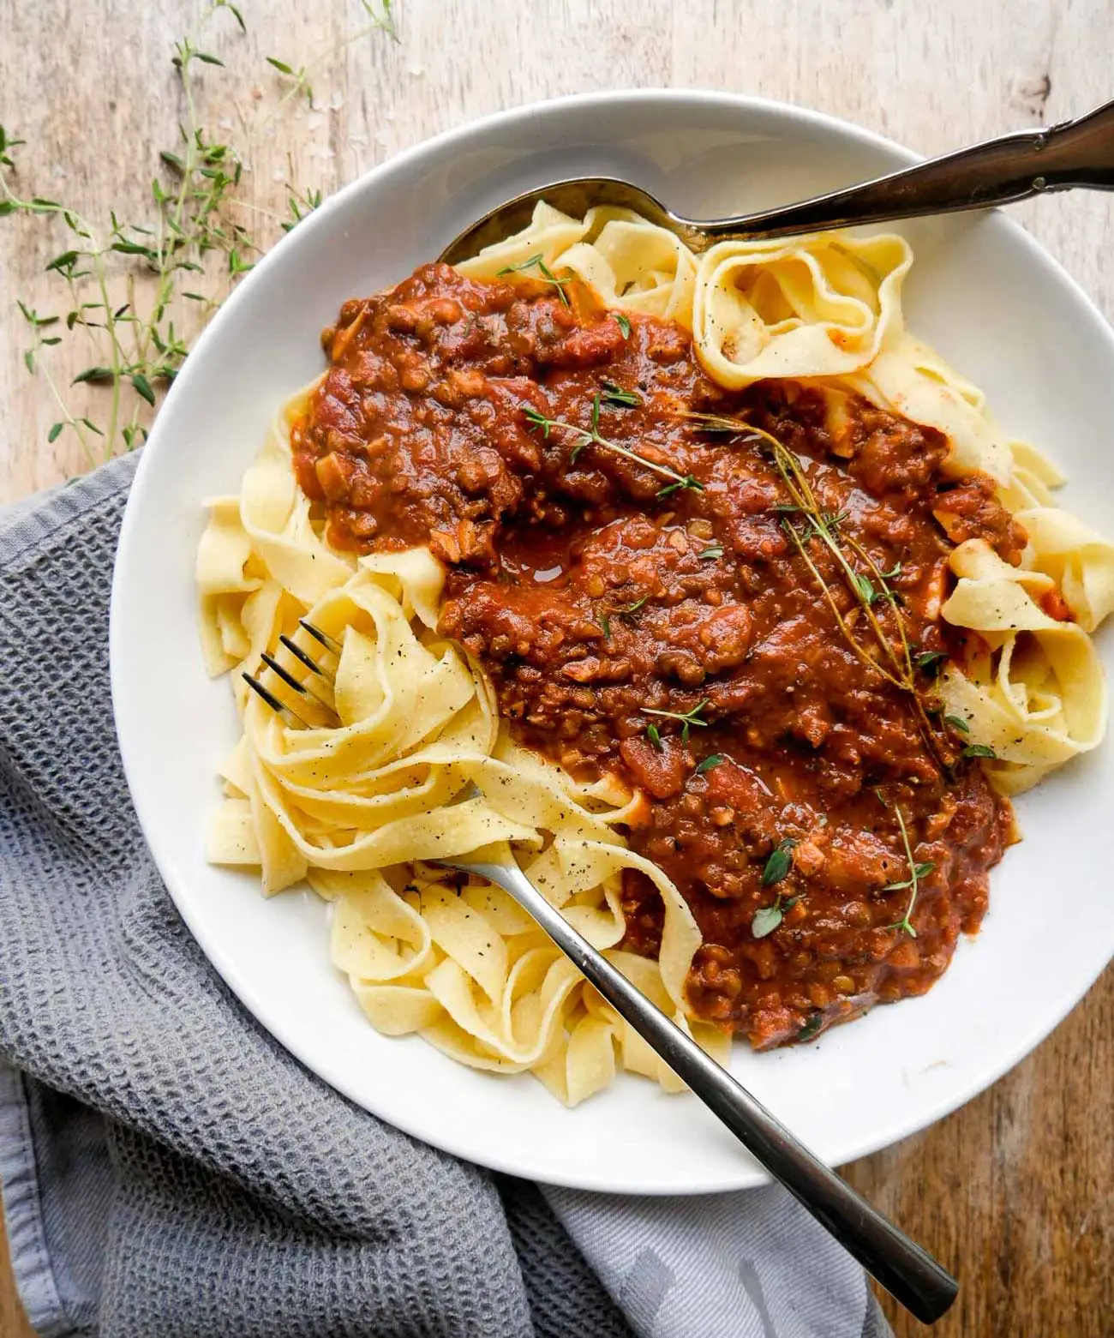
Vegan Bolognese
Pour a little oil into a large pan and add finely chopped onions and garlic.
Rinse and chop the brown mushrooms finely – and pour into the pan. Rinse and pour in the pre-cooked lentils together with cumin, paprika and possibly chili (can be omitted). Simmer for a few minutes. (Here you can also add, for example, finely chopped carrots, eggplant, celery or squash if you want more vegetables in).
Add tomato paste, chopped tomatoes, 1 dl. red wine, vegetable broth and 1 dl. water. Simmer all ingredients well and thoroughly for 15-20 min. on low/medium heat. Stir once in a while, but otherwise let it take care of itself. Season with salt and pepper.
Cook spaghetti and serve together with the finished bolognese, salt, pepper and fresh thyme.
1 large onion
3 cloves of garlic
200g. brown mushrooms
240g. cooked lentils, (equivalent to 1 can)
2 tsp. paprika
1/2 tsp. chili (can be omitted)
70g. tomato paste, 2 tbsp.
400 ml. chopped tomatoes, 2 cans
1 dl. vegetable broth
Salt and pepper
Oil for frying
For serving:
Spaghetti

Slide 5
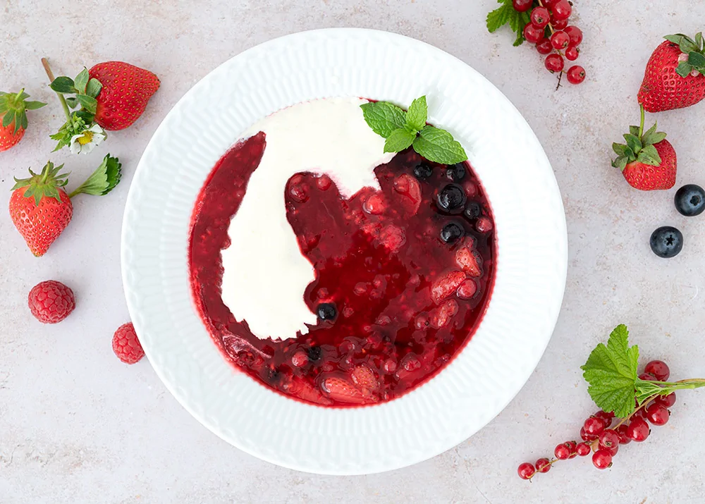
Red porridge with cream
Here's how you do it
Clean the rhubarb and cut them into small pieces of approximately one cm. Place them in a medium saucepan with the frozen berries (wait for delicate berries such as raspberries and blackberries), sugar, vanilla powder, lemon zest and water.
Bring to the boil slowly and then simmer gently for five minutes.
Dissolve the potato flour in a little cold water and then mix into the porridge to smooth it a little.
Finally, fold raspberries and/or blackberries into the porridge and taste with a squeeze of lemon juice and possibly extra sugar. Turn off the heat and let the beets cool down.
30 min : 6-10 portions
450 g rhubarb
250 g strawberries (frozen)
300 g blueberries, blackcurrants, currants, blackberries or raspberries (frozen. I used 100g blueberries and 200g raspberries)
200 g of sugar
0,5 tsp vanilla powder
The zest from 1 lemon + a splash of juice
1,5 dl of water
1 tablespoon potato flour

Slide 6

Brownies
Here’s how you do it
Preheat the oven to 180 degrees, conventional oven - and prepare a dish (approx. 20 cm) with baking paper or grease.
In a standing bowl, mix the dry ingredients, wheat flour, cocoa powder, sugar and vanilla sugar. Mix it together.
Next, add sunflower oil, melted chocolate and almond milk. Mix it all together well until you get a smooth dough.
Pour the batter into the dish and bake for 25-30 minutes. Feel free to check continuously, using a knife or a wooden skewer.
Let your brownies cool or eat right away.
35 min : 10-12 portions
140 g Wheat flour
20 g Cocoa powder
180 g Sugar
80 ml Sunflower oil Or similar.
1 teaspoon vanilla sugar
200 g Vegan chocolate Melted.
240 ml almond milk

Slide 7
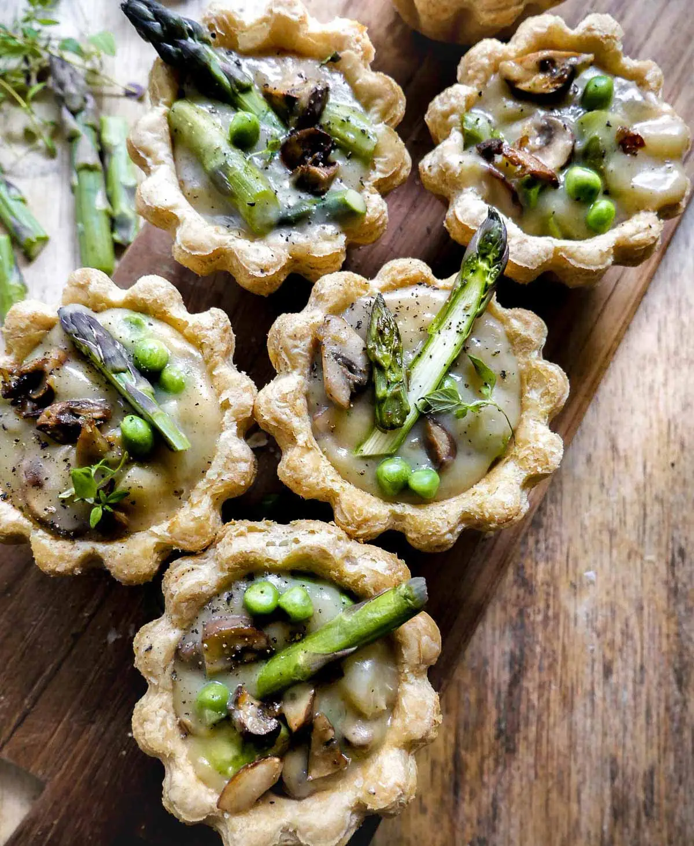
Tartlets with mushrooms and asparagus
Chop mushrooms and onions into small cubes. Pour a little oil on a pan and fry the onions. Add the mushrooms and fry for a few minutes. Cut green asparagus into smaller pieces and fry in the pan for the last 2-3 minutes. Turn off the pan and save for later.
Turn on the oven at 200°C.
Tart filling: Add vegetable butter to a pan. When it has melted, add flour. Quickly whip together into a dough ball with a whisk. Stir in the milk and keep stirring over medium heat. Put 1 vegetable broth in the pot together with 1 dl. water. Sprinkle with freshly ground pepper. Let it boil together while stirring. It will take a few minutes. If the sauce becomes too thick, you can add a little extra water.
Drain the water from the white asparagus and cut them into bite-sized pieces. Pour them into the sauce together with peas, fried onions, mushrooms and green asparagus. Save any a little to decorate with.
Put the tartlet bases on a wire rack and heat them in the oven for 2-3 minutes. Pour the filling into the hot, crispy tartlets.
Garnish with asparagus and mushrooms - and sprinkle with salt and pepper.
20 min : 8-10 portions
Tart bottoms
2 tbsp. Vegetable butter
2 tbsp. Flour
4 dl. Plant milk (oat, soy or almond milk)
1 DL. Vegetable broth
Freshly ground pepper
Tart filling:
200g. Mushrooms
0,5 onion
150g. Green Asparagus
200g. White Asparagus, possibly from glass
100g. Peas, thawed
Oil for frying

Slide 8
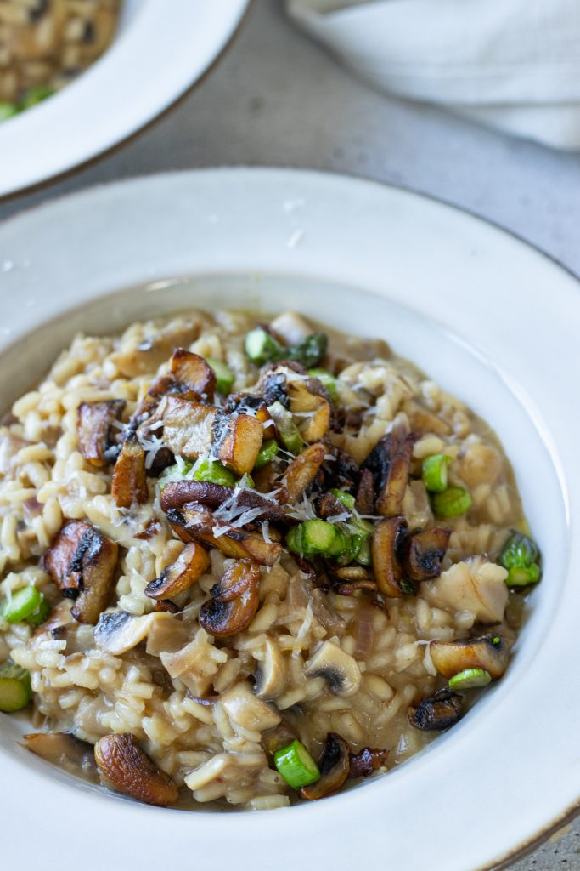
Risotto
Saute the onion and garlic in a pan with oil until the onions are clear and soft. Add rice and stir well. Pour 1 dl of vegetable broth into the pan and stir until the rice has absorbed the moisture. Add more vegetable broth a little at a time until all the moisture is used and the rice is tender.
Toast the champignons in a very hot pan with butter for 2 minutes and then stir them in the pan with risotto along with freshly grated Parmesan. Season with salt and freshly ground pepper.
Serve with grated Parmesan and parsley.
1 onion, finely chopped
1 clove of garlic, finely chopped
400 g risotto rice
300 g champignons
1 liter of vegetable broth
50 g Parmesan, freshly grated
2 tbsp olive oil
salt
black pepper, freshly ground
For serving
50 g Parmesan, freshly grated
1 handful of broadleaf parsley, freshly chopped

