Slide 1
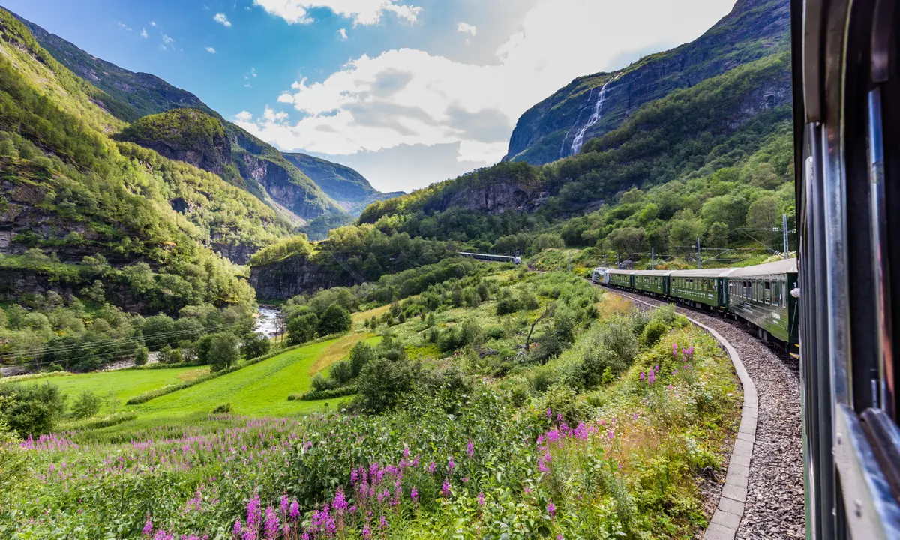
Sustainable tourism

Slide 2
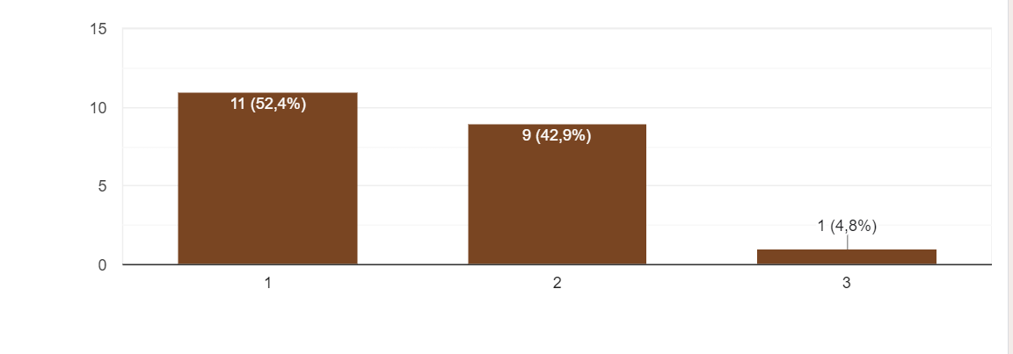
Do you believe in the concept of sustainable tourism?
Very much
Not at all

Slide 3
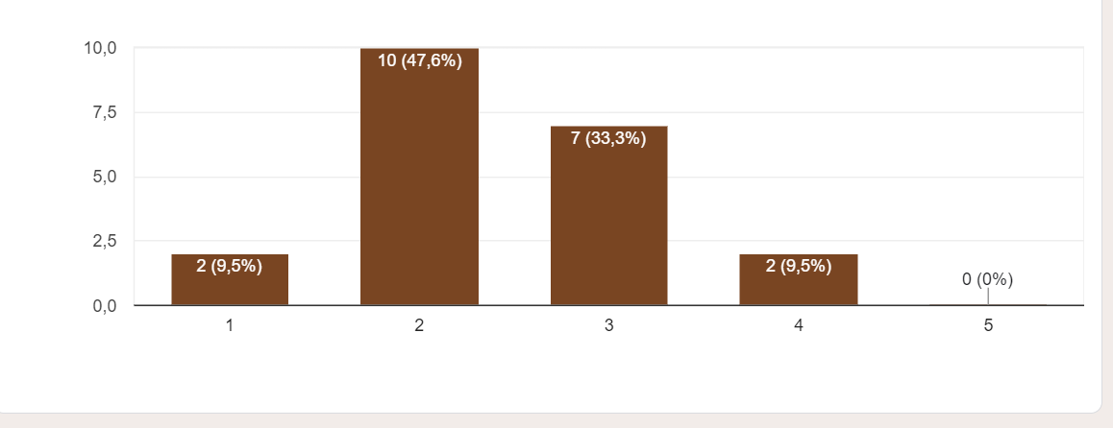
Do you think the protection of local heritage and tourism can go together?
Strongly agree
Strongly disagree

Slide 4
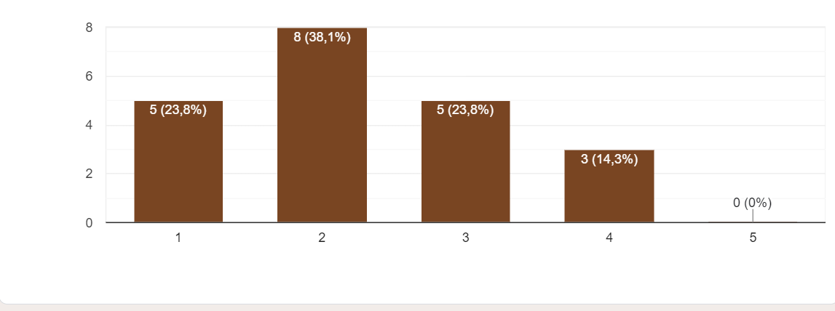
3. Do you believe the community would benefit from developing a sustainable tourism framework?
Strongly agree
Strongly disagree

Slide 5
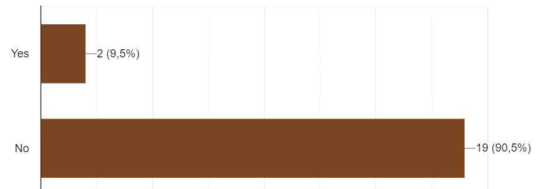
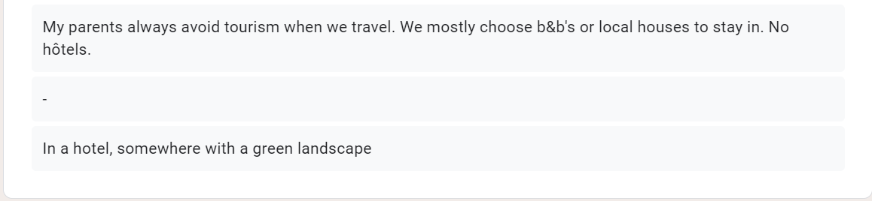
Have you ever stayed in a form of accommodation with 'green' accreditation?
If you said "yes" in question 4, please, specify your answer.

Slide 6
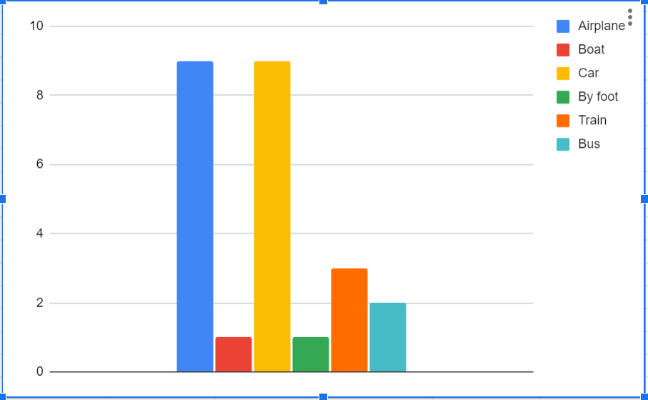
During your last trip, what was your main mode of transport?

Slide 7
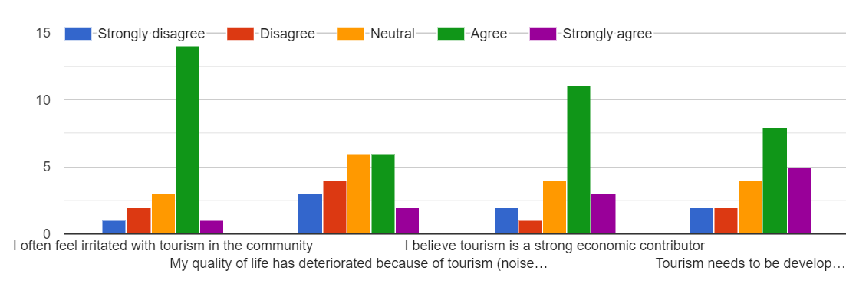

Slide 8
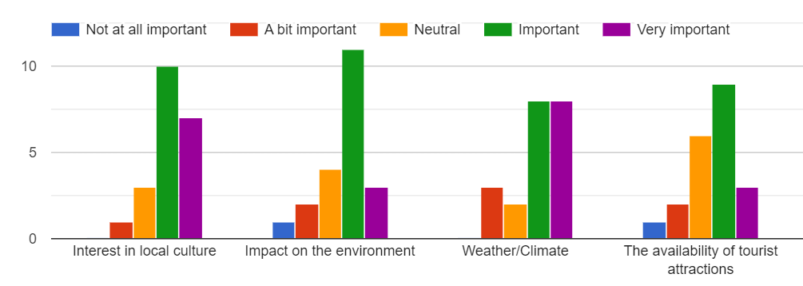
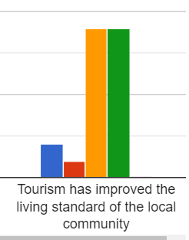

Slide 9
